Slide 1

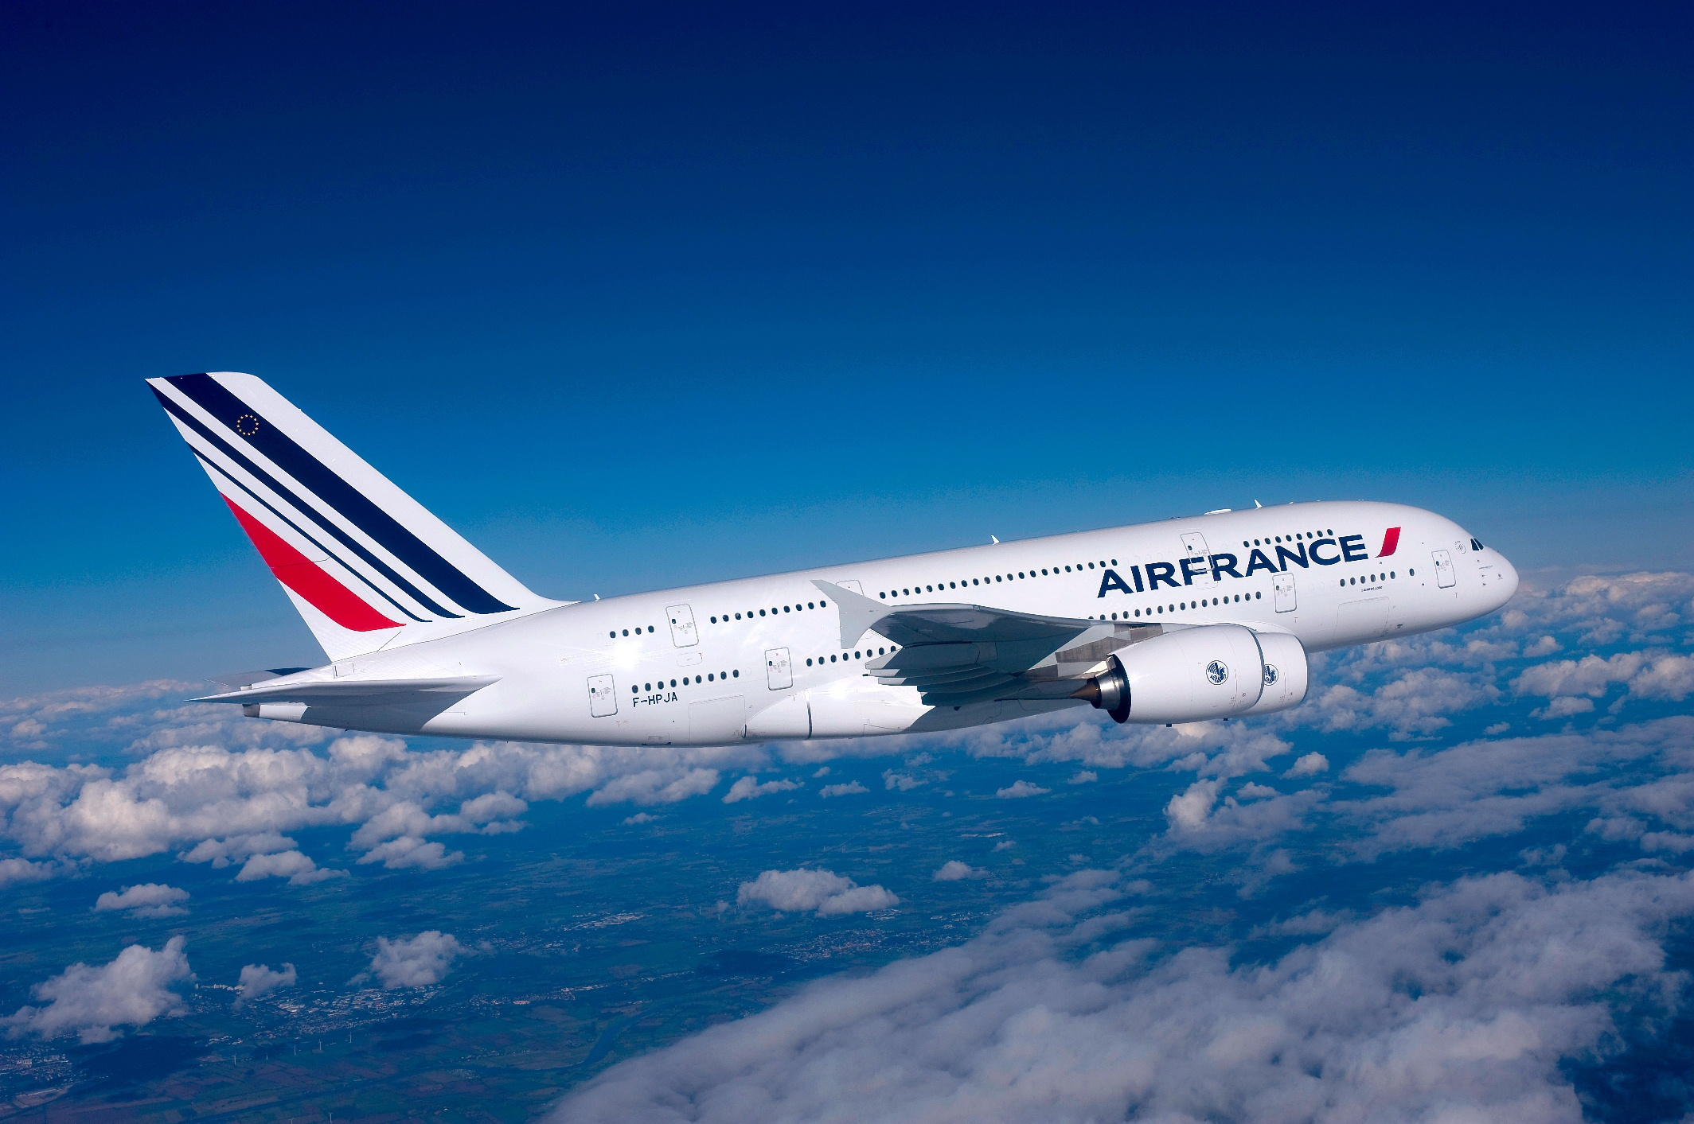

Slide 2
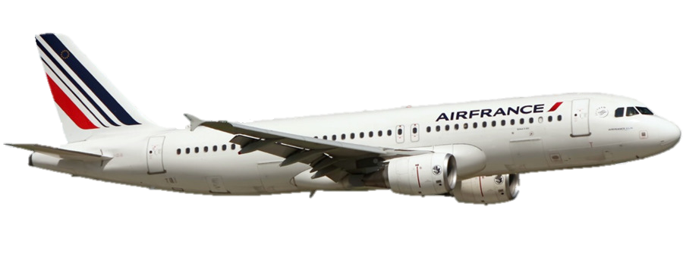
Air France – KLM in 2006
Global Leader
240 destinations in 105 countries
Profitable growth
23.1 billion euros of revenues
1.2 billion euros of operating income

Slide 3
Digital Advertising Is Not Fully Supporting AF Growth
Inefficient resource allocation
Undefined long-term strategy
Not recognizing brand equity online
1
2
3
Notes:
Undefined long-term strategy
Missing KPIs and targets
Inefficient resource allocation
Large cost being wasted
More “shooting blind everywhere”
Lack of understanding in media providers offer

Slide 4
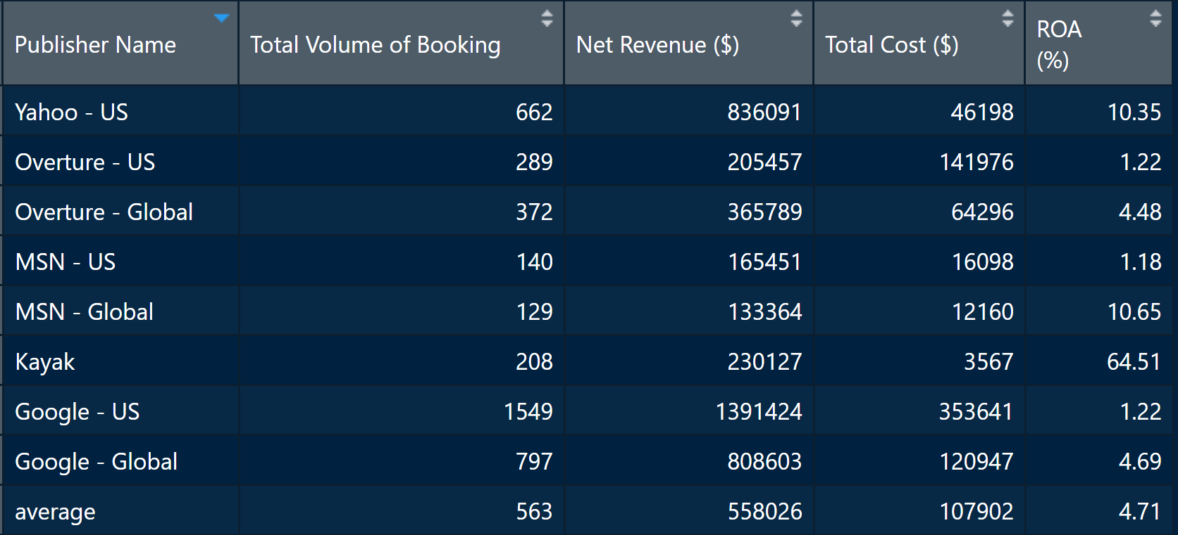
Air France Media Campaigns
Google : advantage of cost per click and higher click through rate
Yahoo : strong keyword match
Microsoft : more geotargeted

Slide 5
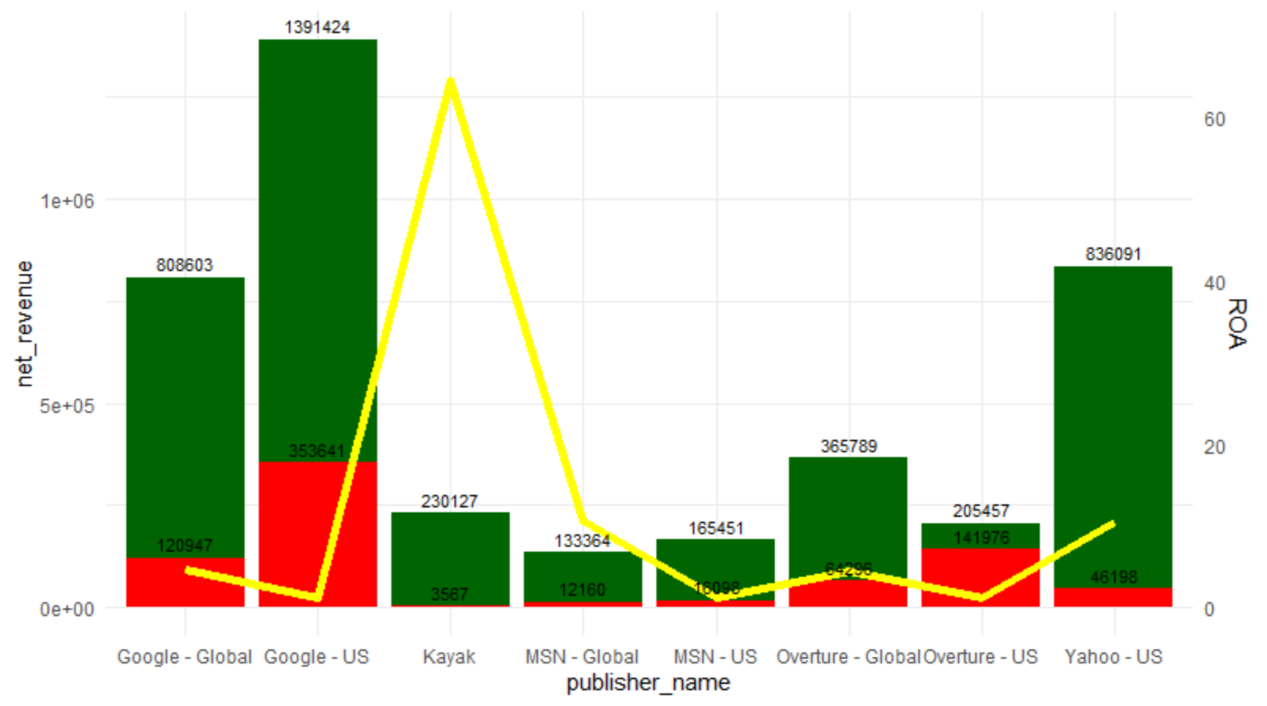
Current Cost Analysis
Google Revenue 1.4M USD
Kayak ROA at 65%
Weaker ROA for traditional publisher due to no keyword optimization
Revenue
Cost
ROA

Slide 6
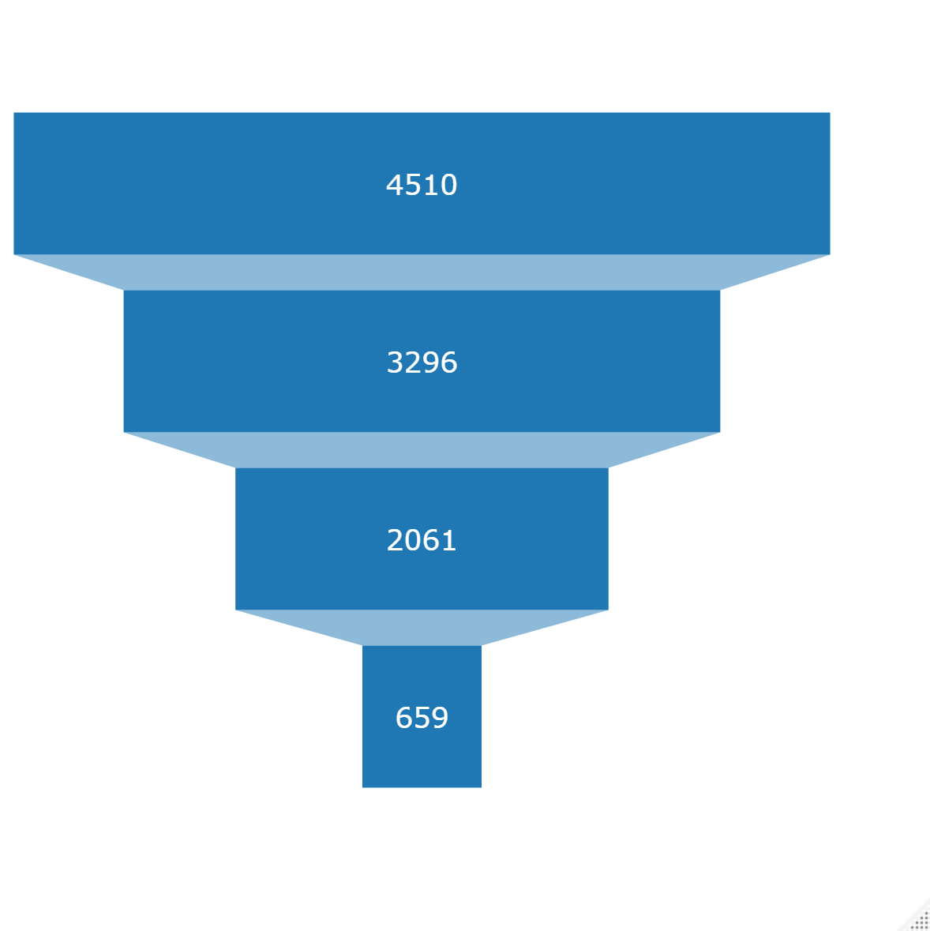
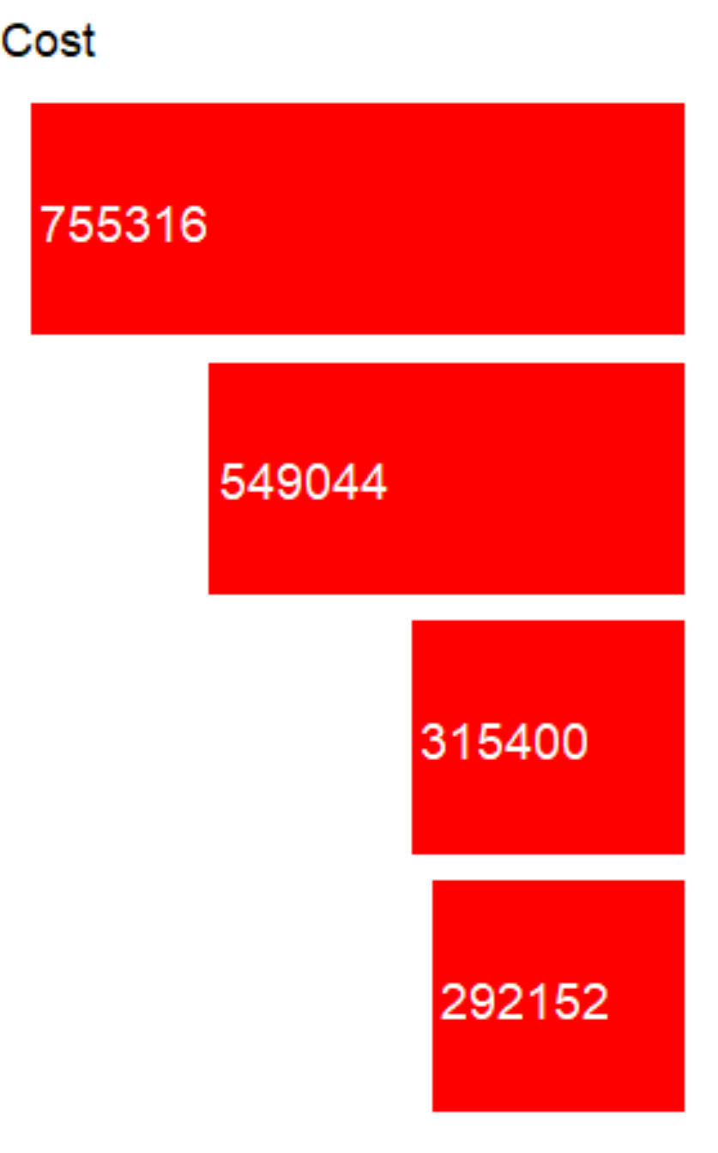
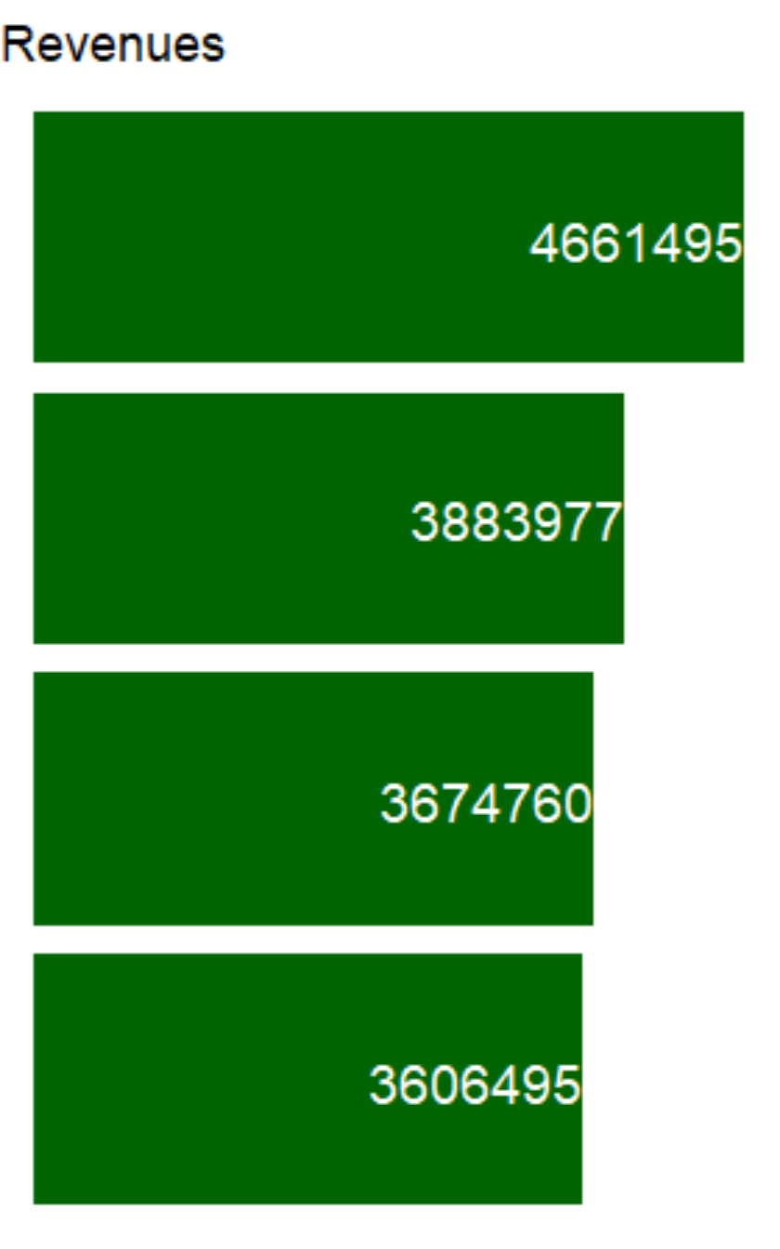
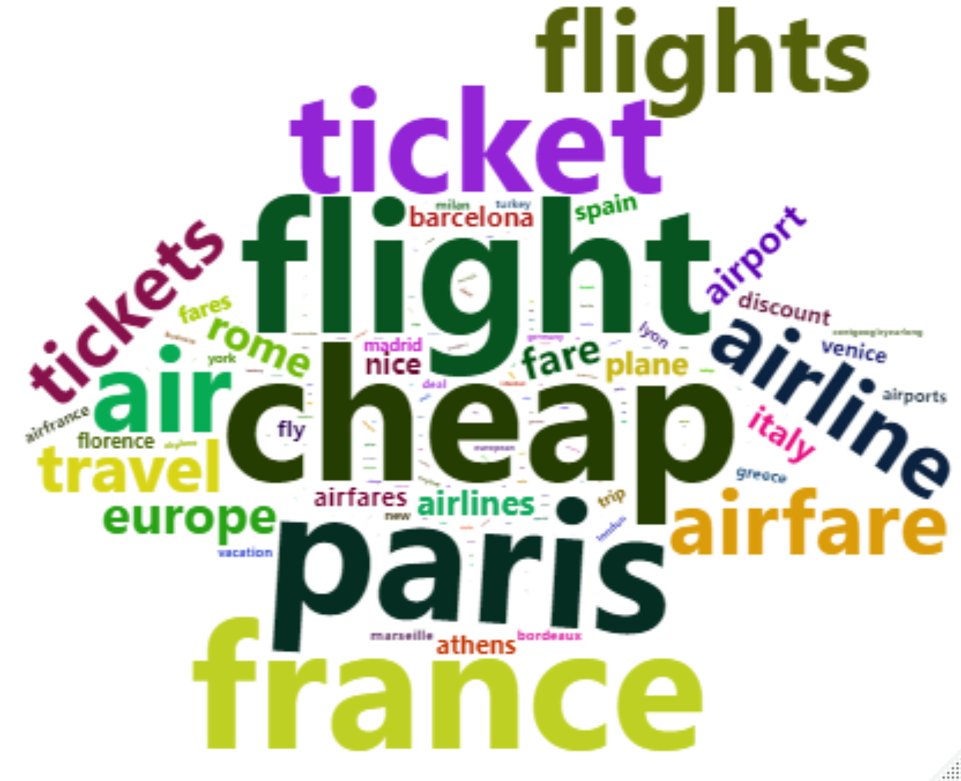
Keyword Optimization
All Keyword
Main Publisher
Branded and Geotargeted
Branded
- 61.3%
- 22.6%
Notes:
What does the data says
Most influential campaigns
Most important metrics to watch for
What brings the highest returns
Our keyword optimization has let us recognize the majority of repeated keywords and as you can see out of all only a few are bringing back sales.
One thing to consider is that we are looking at the US market and most of the keywords we are seeing like cheap, paris, France….. Indicates that American people want to go for holiday or business narrowing it down to show our customer segment and what they are looking for.

Slide 7
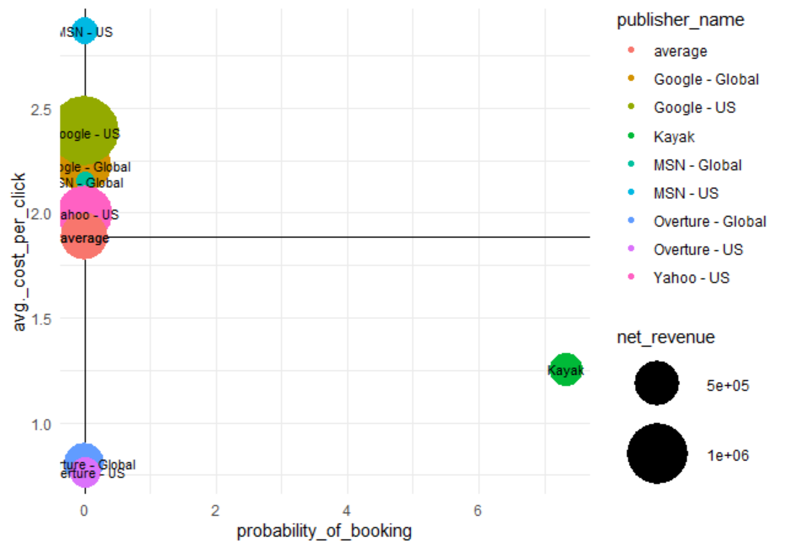
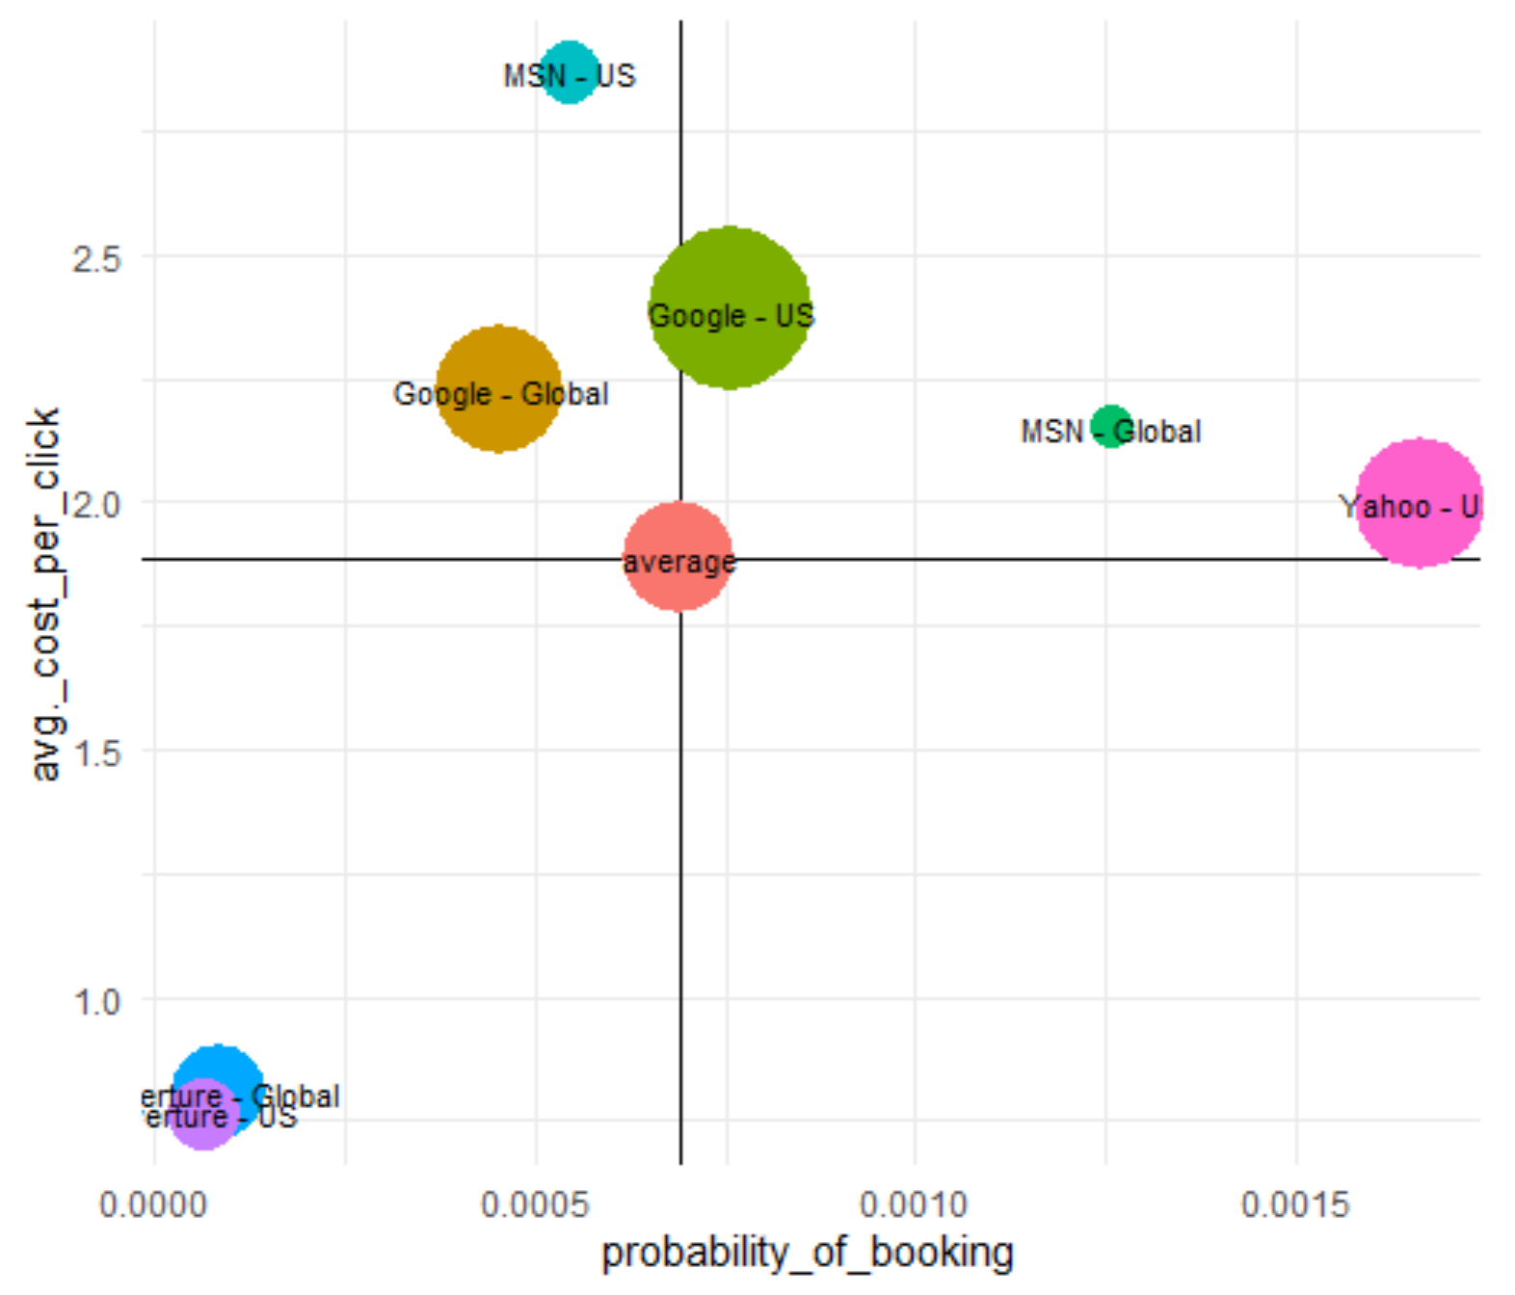
Kayak and Metasearcher Potential

Slide 8
Recommendations
1
Keyword Optimization
Budget reallocation towards Meta-searchers
Strengthen Brand equity
2
3

